Slide 1
Advanced Decisions and Loops
Chapter 5

Slide 2

5.1
Some Simple Schoolroom Statistics

Slide 3
It All Adds Up: Summing
Program to sum test scores using a sentinel value to end the input:
1. <html> <head>
2. <title>Summing</title>
3. <script>
4. function getSum() {
5. var score = 0; var sum = 0;
6. while (score != -999) {
7. sum = sum + score;
8. score = parseInt(prompt("Enter a score or
enter -999 when you're finished:"," "));
9. }
10. document.write("the sum of these scores is: “ + sum + ".");
11. }
12. </script> </<head>
13. <body>
14. <h3>Click to enter students' scores</h3>
15. <p><input type="button" id="scores" value="Enter the scores“
onclick="getSum();" /></p>
17. </body> </html>

Slide 4
Computing Averages
To find the average, we must sum and count the numbers entered. The example finds the average of values entered using a counter to keep track of how many values are entered.
1. function getAverage() {
2. var score = 0; var sum = 0;
3. var count = 0; var average = 0;
4. while (score != -999) {
5. sum = sum + score;
6. count++;
7. score = parseInt(prompt("Enter a score or
enter -999 when you're finished:"," "));
8. }
9. average = sum/(count - 1);
10. document.write("<p>The sum of these scores is: " +
sum + ".</p>");
document.write("<p>The average of these scores is: "
+ average + ".</p>");
12. }

Slide 5
Putting it all Together: Sum, Average, Highest, and Lowest Values
1. function getStats()
2. {
3. var score = 0; var sum = 0; var count = 1; var average = 0;
4. var high = 0; var low = 0;
5. score = parseInt(prompt("Enter a score or enter -999 when finished:"," "));
6. low = score; high = score;
7. while (score != -999) {
8. sum = sum + score;
9. count++;
10. score = parseInt(prompt("Enter a score or -999 when finished:"," "));
11. if (score > high)
12. high = score;
13. if ((score < low) && (score != -999))
14. low = score;
15. }
16. average = parseInt(sum/(count - 1));
17. document.write("<p>Number of scores entered: " + (count - 1) + ".</p>");
18. document.write("<p>Sum of these scores: " + sum + ".</p>");
19. document.write("<p>Average of these scores: “ + average + ".</p>");
20. document.write("<p>Lowest score is: " + low + ".</p>");
21. document.write("<p>Hghest score is: " + high + ".</p>");
22. }

Slide 6
Is it Odd or Even?
It is often important to identify if a number is even or odd.
If a number is odd, then it will have a remainder when divided by 2. That remainder will always be 1. If it is even, the remainder, when dividing by 2 will be 0. We can use that to check if a number is odd or even.
Given a numeric variable, myNum:
If myNum % 2 == 1 → myNum is odd
If myNum % 2 == 0 → myNum is even

Slide 7
Some Math methods
The Math.round() method rounds off floating point numbers mathematically to an integer value
Math.round(89.001) results in 89
Math.round(89.678) results in 90
The Math.floor() method truncates the decimal part of any floating point number
Math.floor(89.001) results in 89
Math.floor(89.678) results in 89
The Math.ceil() method rounds any floating point number up to the next integer
Math.ceil(89.001) results in 90
Math.ceil(89.678) results in 90

Slide 8
5.2
To Continue or Not to Continue?

Slide 9
The break statement
The break statement is essential to a switch structure. It can also be used in a loop if necessary but often creating a compound condition can do the same thing. The general pseudocode for a possible use of the break statement is given. In this situation a user can continue shopping until a maximum amount is spent. Then the user should be informed that further purchases will increase shipping charges.
Declare and initialize variables
Start a while loop
Prompt the user for the item desired and how many will be bought
Use a switch to identify the cost of that item, calculate cost of the number of that item ordered, keep a running sum of the total cost.
Check if total cost puts the user over the max allowed
If this is true, break out of the loop and inform the customer that another item will increase the shipping cost
Continue with the loop until the customer is done shopping

Slide 10
The continue Statement
The continue statement allows you to skip an iteration in a loop once (or more, depending on the conditions) but return and complete more iterations.

Slide 11
Counting by Threes
The following program uses the continue statement to count by threes:
1. function getThrees()
2. {
3. for (var i = 0; i <= 100; i++)
4. {
5. if ((i/3) != parseInt(i/3))
6. { continue; }
7. document.write(i + " &nbsp;&nbsp;");
8. }
9. }
Output will be:
0 3 6 9 12 15 18 21 24 27 30 33 36 39 42 45 48 51 54 57 60 63 66 69 72 75 78 81 84 87 90 93 96 99

Slide 12
5.3
Nested for Loops

Slide 13
Desk Checking
Most important when programs become complex
Use pencil and paper to go through the program, line by line
Write down the value of each variable at each line and any output

Slide 14
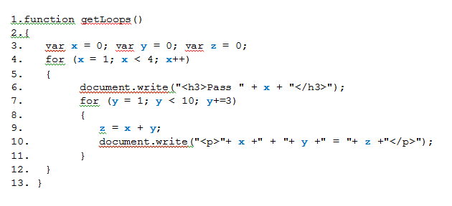
Example
Pass | value of x | value of y | value of z | output
Outer pass 1 | 1 | 0 | 0
Inner pass 1 | 1 | 1 | 2 | 1 + 1 = 2
Inner pass 2 | 1 | 4 | 5 | 1 + 4 = 5
Inner pass 3 | 1 | 7 | 8 | 1 + 7 = 8
loop ends,test fails | 1 | 10 | 8
Outer pass 2 | 2 | 10 | 8
Inner pass 1 | 2 | 1 | 3 | 2 + 1 = 3
Inner pass 2 | 2 | 4 | 6 | 2 + 4 = 6
Inner pass 3 | 2 | 7 | 9 | 2 + 7 = 9
loop ends, test fails | 2 | 10 | 9
Outer pass 3 | 3 | 10 | 9
Inner pass 1 | 3 | 1 | 4 | 3 + 1 = 4
Inner pass 2 | 3 | 4 | 7 | 3 + 4 = 7
Inner pass 3 | 3 | 7 | 10 | 3 + 7 = 10
loop ends, test fails | 3 | 10 | 10

Slide 15
Which Way Should Loops Be Nested?
No clear answer to this question.
You can nest a pre-test loop inside a post-test loop
Or nest a for loop inside a while loop or nest several while loops inside a for loop or any other combination.
The programming problem that you are faced with may determine how you write the code.
If there is no clear reason to select one option over another, the choice is yours.

Slide 16
5.4
Drawing Shapes and Patterns

Slide 17
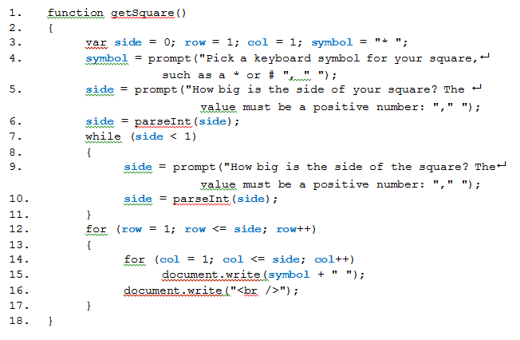
Drawing A Square

Slide 18
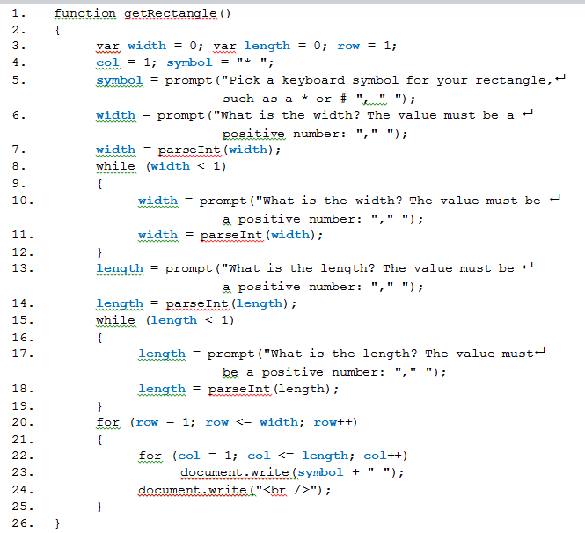
Drawing A Rectangle

Slide 19
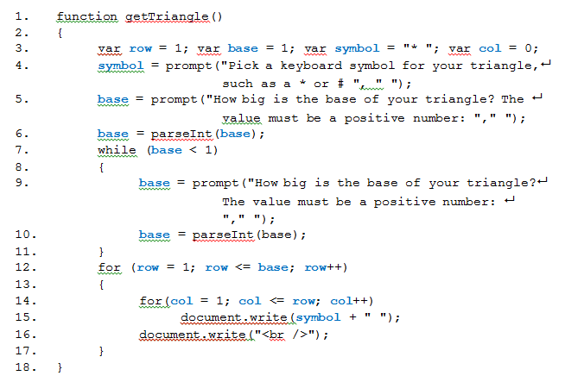
Drawing A Right Triangle

Slide 20
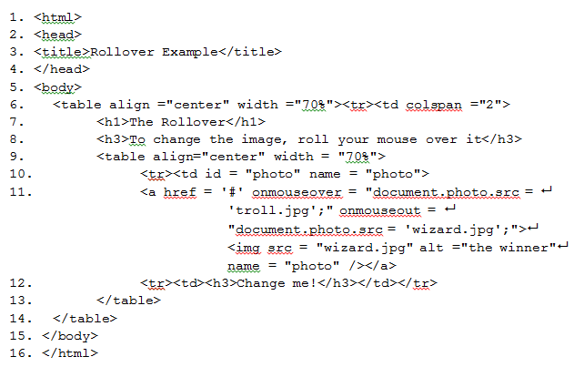
Mouse Events: Creating a Rollover
In this example the JavaScript is within the HTML page, not in the <head> section. All the code is on lines 10-11. Line 10 identifies the element we are changing with id = "photo".

Slide 21
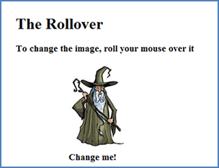
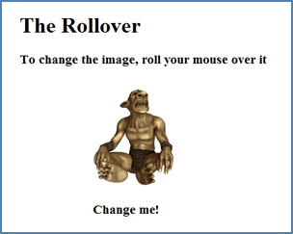
If you enter and run this code, you will first see:
If you run your mouse over the wizard
you will see:
And, finally, if you move your mouse
off the image, you will see:

Slide 22
More Mouse Events
Attribute | Value | Description: what it does
onclick | JavaScript | what happens when the mouse is clicked
ondblclick | JavaScript | what happens when the mouse is double-clicked
onmousedown | JavaScript | what happens when a mouse button is pressed
onmousemove | JavaScript | what happens when the mouse pointer moves
onmouseout | JavaScript | what happens when the mouse pointer moves off an element
onmouseover | JavaScript | what happens when the mouse pointer moves over an element
onmouseup | JavaScript | what happens when the mouse button is released

